Slide 1
House Tax Billing System
Pasunoori yashwanth reddy
Employee ID:174800

Slide 2
CONTENT:
ABSRACT
EXISTING SYSTEM
PROPOSED SYSTEM
PROJECT MODULES
USE CASE DIAGRAMS
CLASS DAIGRAMS
SEQUENCE DIAGRAM
ER DIAGRAM
FLOW CHART
ACTIVITY DIAGRAM
Software Requirements
Conclusion

Slide 3
ABSRACT:
Main aim of this House Tax Billing System project is to implement an application which deals with maintaining House tax managing activities like generating a House tax bill, customer personal records and other administrative activities.
Initially, all the information about customers will be entered and maintained, which in turn helps to generate House tax bill based on the customer’s area. This system will reduce manual work for maintaining records in files.

Slide 4
EXISTING SYSTEM:
The house billing system maintains information of customers. The data of customers is stored in a single file which consists of customers information, bills file, tracking bills to know the status of bills.
In existing house billing system customer bills will take long time to get the information, Searching of particular customer information is tough.

Slide 5
PROPOSED SYSTEM:
The house billing system stores customer information. It calculates the house tax of the customer based on area.
It is calculated by maintaining different files such as customer information file, bills files, tracking bills for the status of the bill of each customer.
All the information of customer can be searched by using ID number.

Slide 6
PROJECT MODULES:
Managing Customer records
To create customer file
To update customer file
To generate Reports
To search for customer information
Managing the generated bills
To create Bills file
To update bills file
To generate Reports

Slide 7
Tracking bill status
To update payments
To notify defaulters
To generate Reports

Slide 8
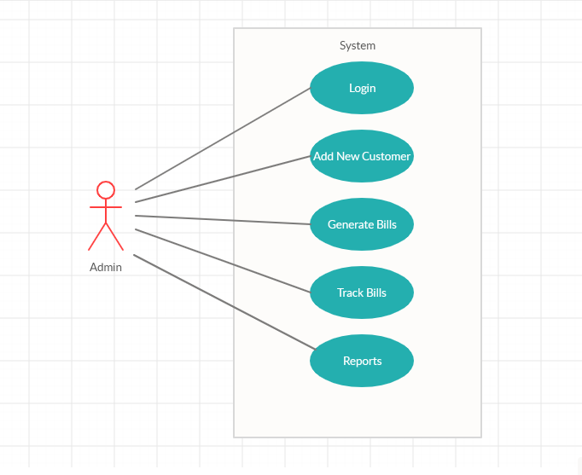
USE CASE DIAGRAM:

Slide 9
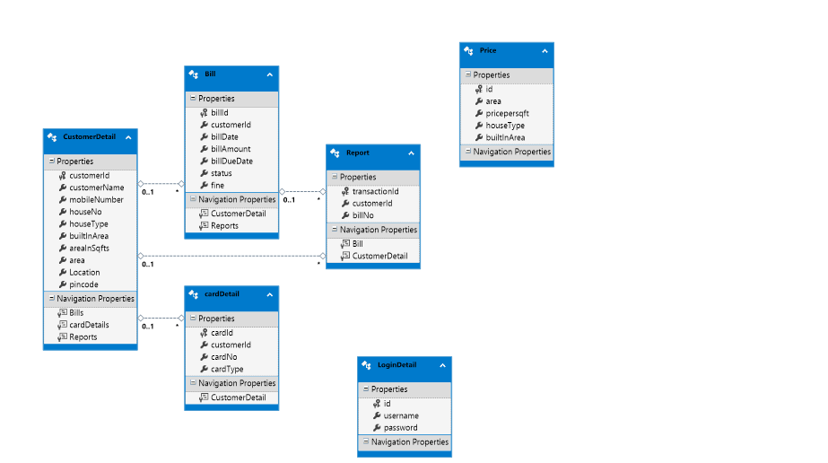
CLASS DIAGRAM:

Slide 10
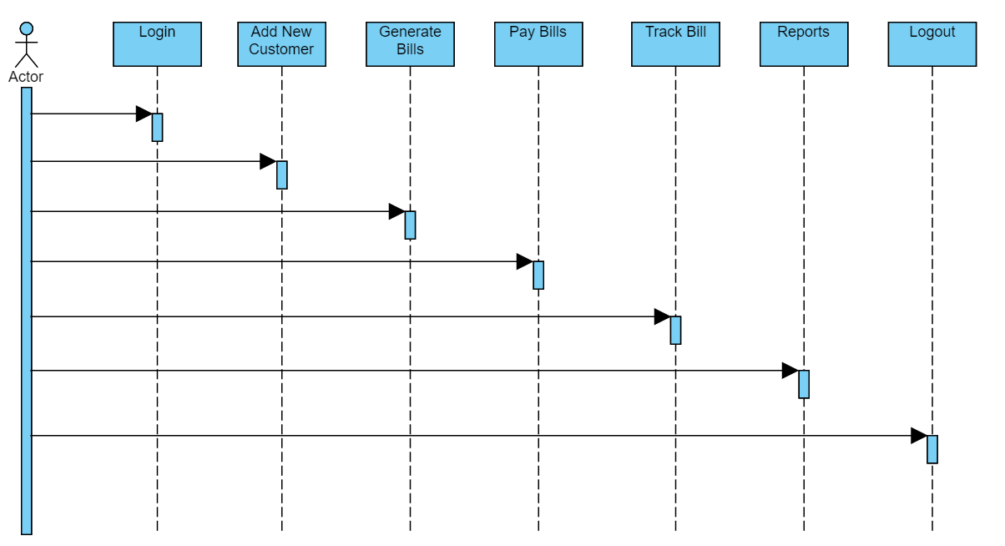
SEQUENCE DIAGRAM:

Slide 11
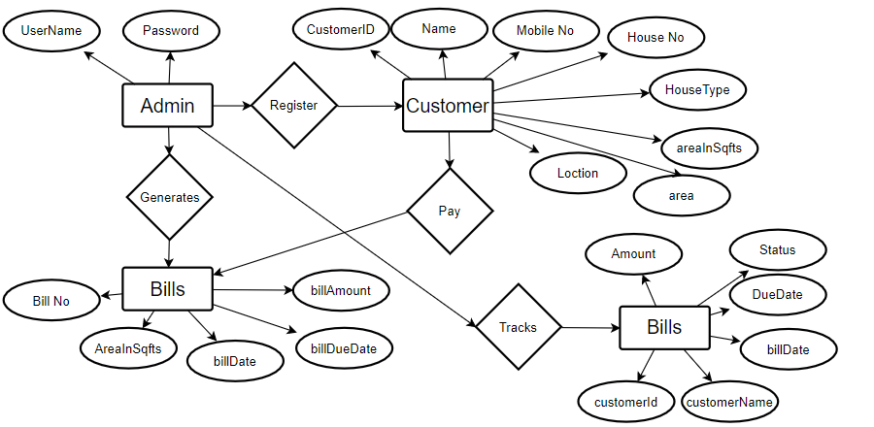
ER DIAGRAM:

Slide 12
FLOW CHART:
Start
Login
NO
If Successful
YES
Add New Customer
Generate Bills
Pay Bills
Track Bills
Report
Logout
End

Slide 13
ACTIVITY DIAGRAM :
Intial State
Login
Add New Customer
Generate Bills
Pay Bills
Tracks Bills
Reports
Logout
Final State

Slide 14
Software Requirements
Operating System : Windows 10
Technology : ASP. Net MVC,C#
Web Technologies :Html, JavaScript, CSS
Web Server :IIS Express
Database :SQL SERVER 2012

Slide 15
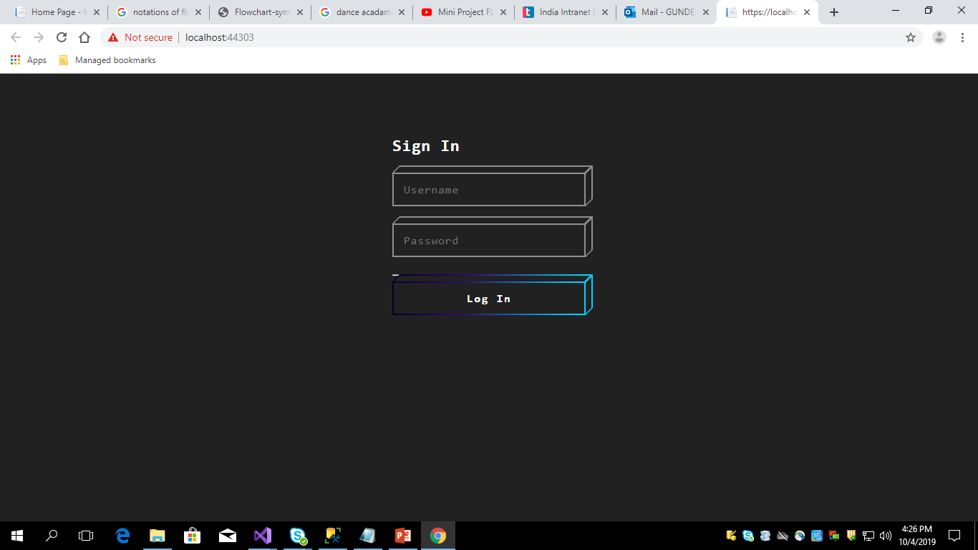
Screen Shots:

Slide 16
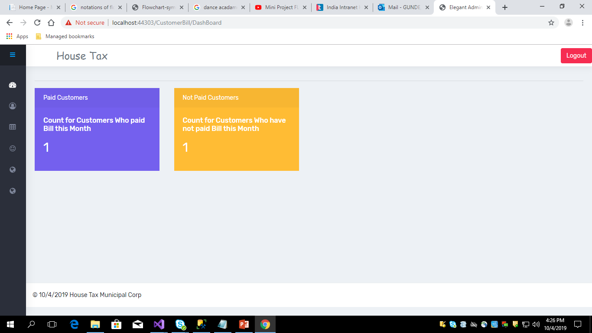
Cont..

Slide 17
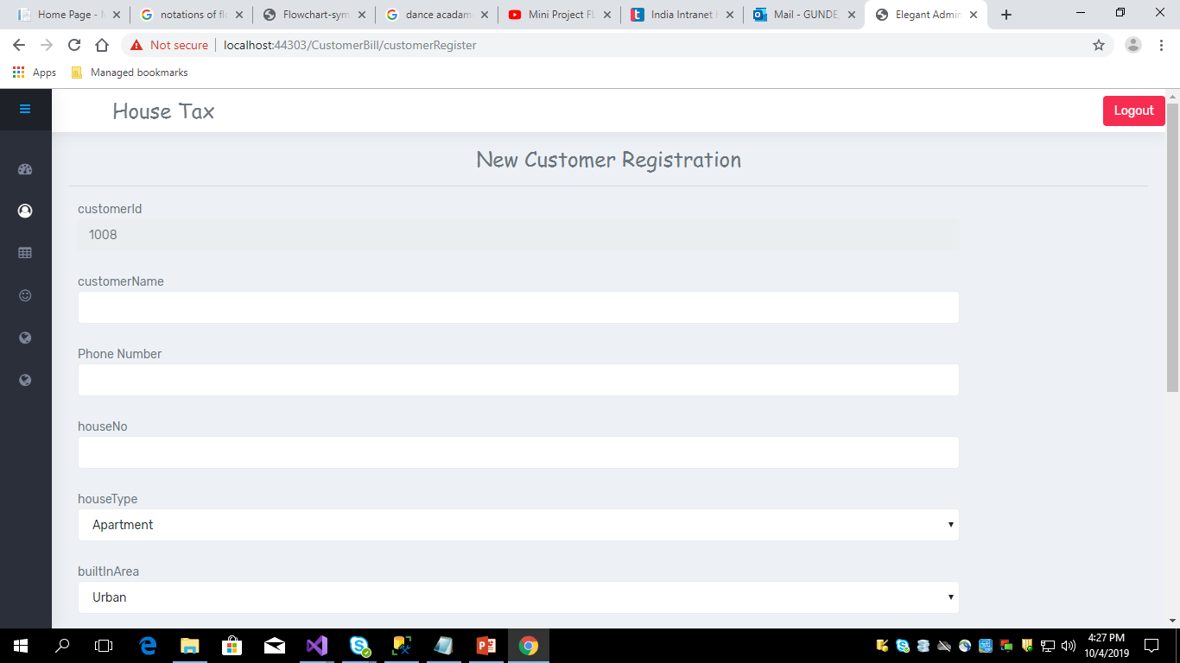
Cont..

Slide 18
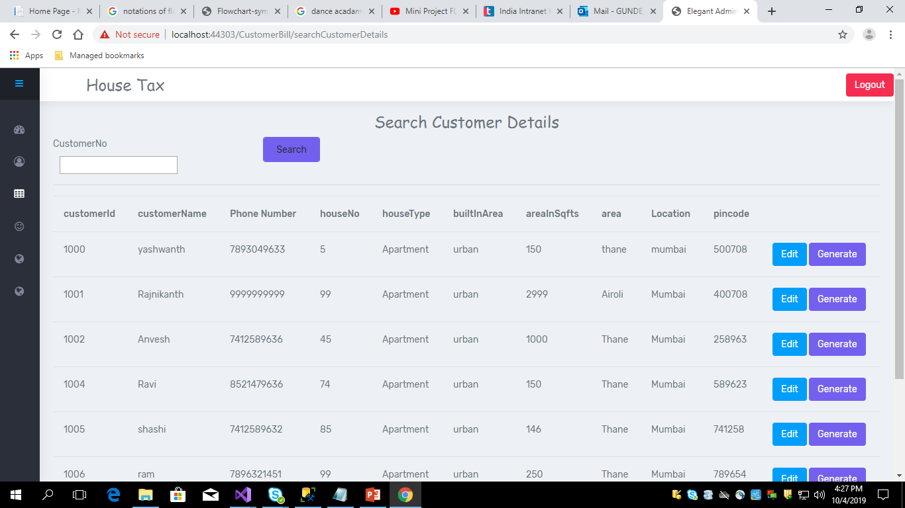
Cont..

Slide 19
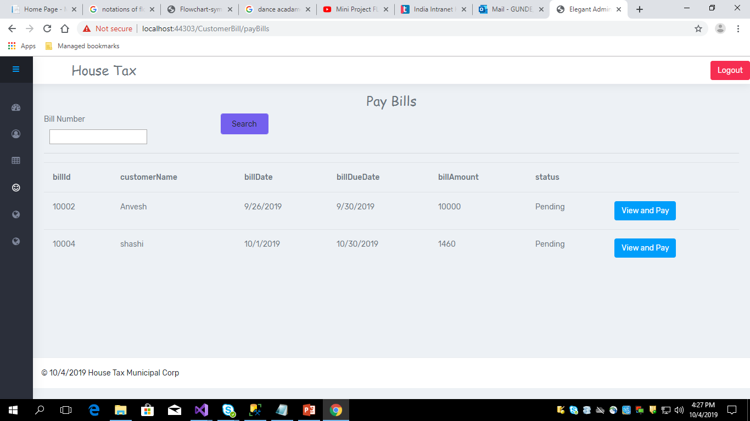
Cont..

Slide 20
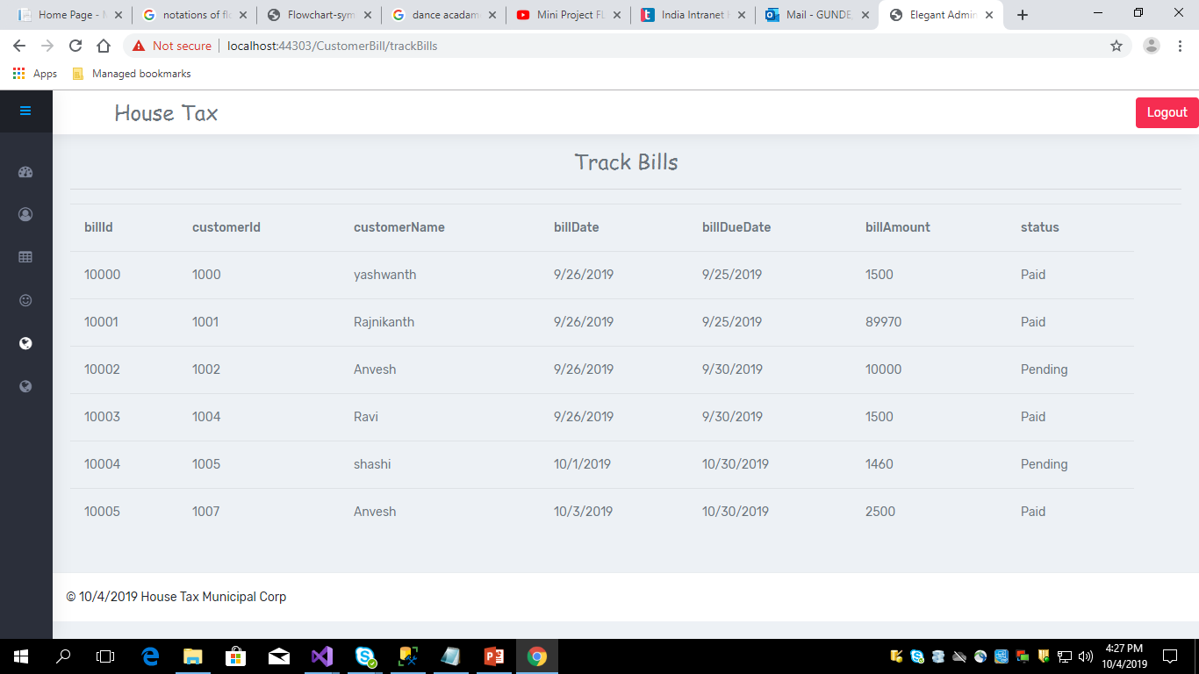
Cont..

Slide 21
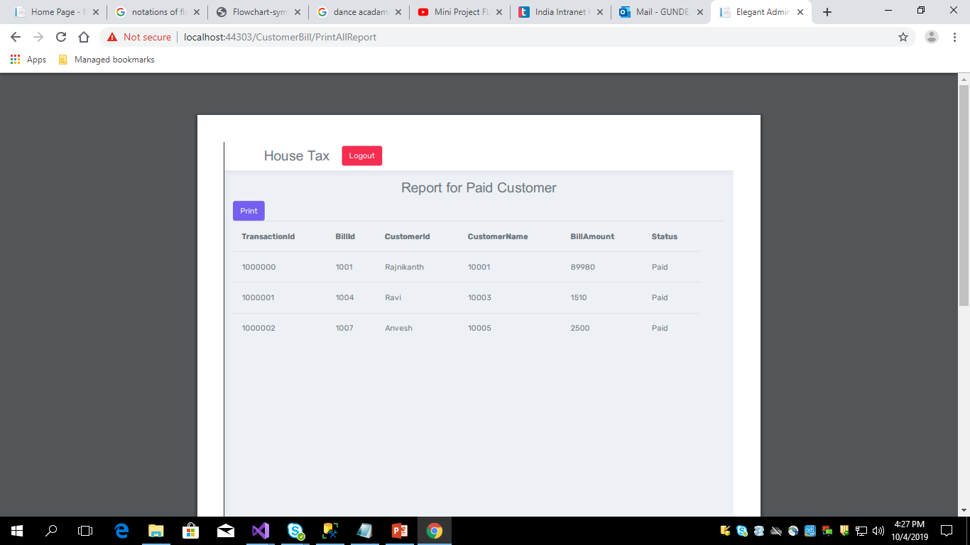
Cont..

Slide 22
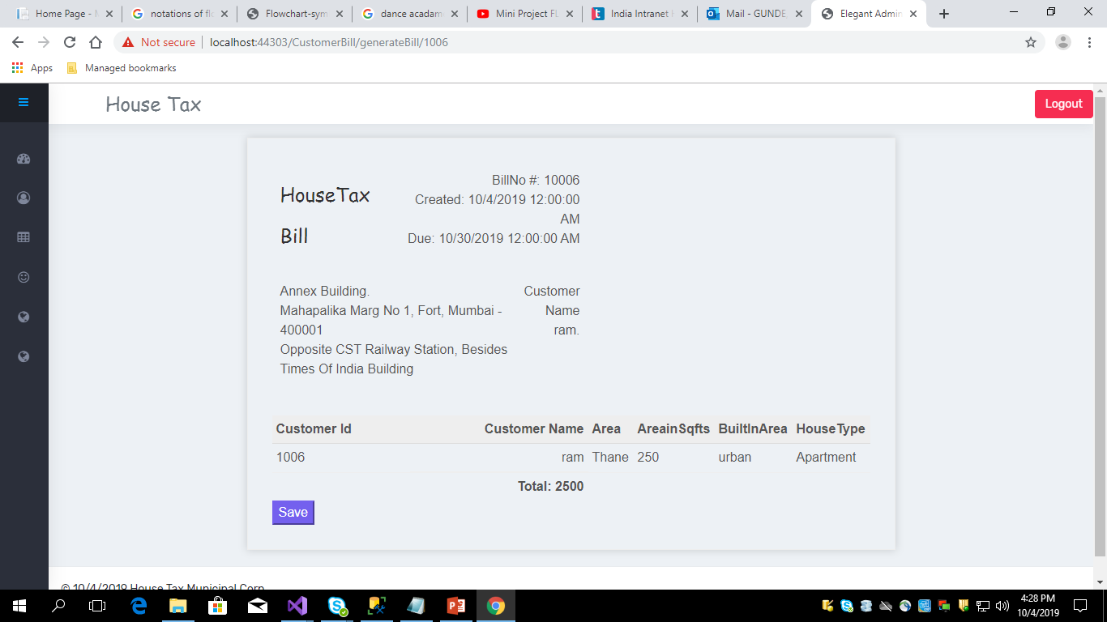
Cont..

Slide 23
Conclusion
We can conclude that we can create Bill for house tax for the registered customer. We can add new customers to the Database.
We can search for a customer in the database and all the details of customers are safe with username and password of the Admin.

Slide 24
Thank You

